Slide 1

COVID-19
STIMULUS MEASUREMENT AND OPTIMIZATION
Presented by:
Pani Maddi
Tory Young
David Frazier
Bob Benton

Slide 2
Economic Stimulus Data
National Economic Data
Personal Expenditure Data
Unemployment Rates
-National Unemployment -State Unemployment
Consumer Expense Data
-Housing -Food -Transportation
-Healthcare
-Etc.
Gross Domestic Product
Consumer Price Index
Household Income
S&P 500 / Dow Jones Index
Disposable Income
National Debt
Net Worth

Slide 3
FOCUS
Impact of Stimulus on the Consumer
Consumer
Businesses
Our primary goal in this study was to focus on the consumer. We reviewed previous recessions and stimulus efforts to predict whether the recent stimulus package would make a sizable impact for the consumer and the economy as a whole.
A large portion of the stimulus was reserved for distressed businesses. While our study focused on the consumer, we acknowledge the large impact the stimulus has on small businesses.

Slide 4

Data Sources
FRED – Federal Reserve Economic Data
FRED provides access to hundreds of economic data points available through CSV or API.
Bureau of Labor Statistics
The Bureau of Labor Statistics provided a wealth of detail on personal economic data such as consumer expenditure and disposable income.

Slide 5
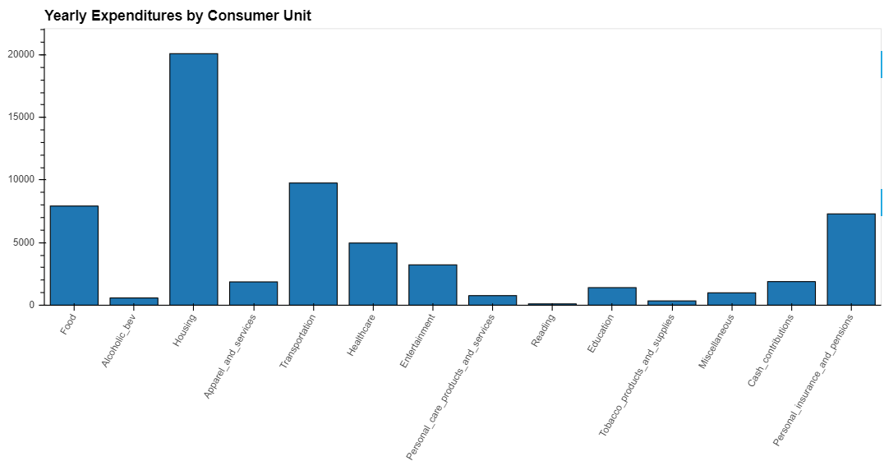
Visualizations
+
Economic Data Dashboard
+
Consumer Data Dashboard

Slide 6

Slides
Fill in the contents of the contents of the contents of the directory
85%
Image & Content
Show and explain your web, app or software projects using these gadget templates. A picture is worth a thousand words!.

Slide 7


Slides
Fill in the contents of the contents of the contents of the directory
TV Apps
A complex idea can be conveyed with just a single still image, namely making it possible to absorb large amounts of data quickly.
₺1234/year
Contraction
Insert the title of your subtitle Here.
Easy to change colors.
Click on the button under the presentation preview that says "Download as PowerPoint template". You will get a .pptx file that you can edit in PowerPoint.
Remember to download and install the fonts used in this presentation (you’ll find the links to the font files needed in the Presentation design slide)

Slide 8

05
Coins
information data

Slide 9




Coins
Fill in the contents of the contents of the contents of the directory
You can simply impress your audience and add a unique zing and appeal to your Google Slide Presentations.
Bring the attention of your audience over a key concept using icons or illustrations
puzzle
settings
support
chart
Is the color of milk and fresh snow, the color produced by the combination of all the colors of the visible spectrum.
all pleasure without pain, is not life at. Take the lot of the happiest - it is a tangled yarn. pleasure

Slide 10
Coins
Fill in the contents of the contents of the contents of the directory
IDEA!
Movies
Editorial
Apps
Business
Technology
Configuration
Insert the title of your subtitle Here
Insert the title of your subtitle Here
Insert the title of your subtitle Here
Insert the title of your subtitle Here
Insert the title of your subtitle Here
Insert the title of your subtitle Here

Slide 11
Coins
Fill in the contents of the contents of the contents of the directory
Support Center
Click on the button under the presentation preview that says "Download as PowerPoint template". You will get a .pptx file that you can edit in PowerPoint. Show and explain your web, app or software projects using these gadget templates.
Stats
01
Mobile
02
Chat 03
Stats 01
Mobile 02
Easy to change colors, photos and text.
Easy to change colors, photos and text.
Likes
04
Chat 03
Likes 04
Easy to change colors, photos and text.
Easy to change colors, photos and text.

Slide 12
Best regards,
Thank you
Special thanks to all the people who made and released these awesome resources for free:
Powered by Freepptbackgrounds.net
Photographs by Picpng.com

